Slide 7
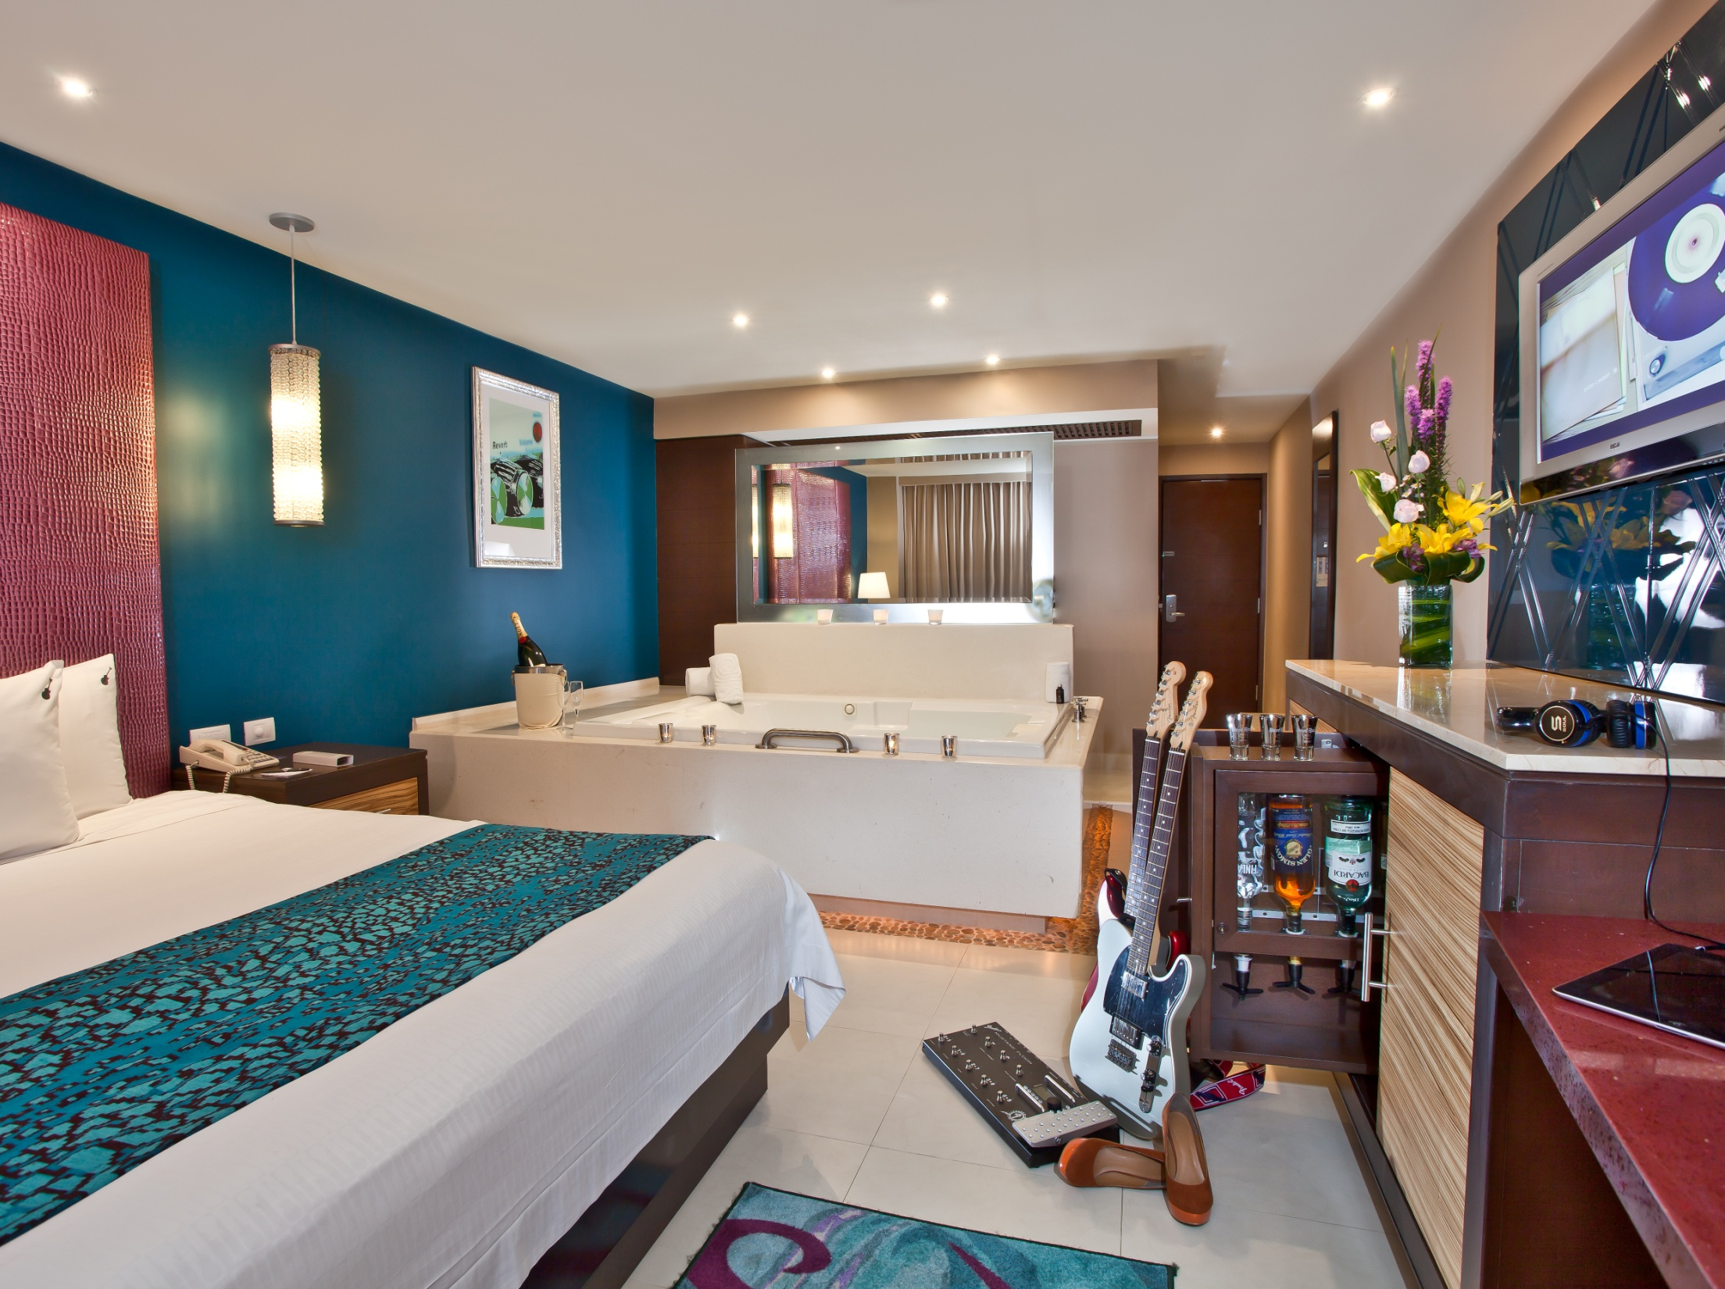
AMENIDADES
24 HRS ROOM SERVICE
MINIBAR
JACUZZI DOBLE
DISPENSADOR

Slide 15
TODO EL DIA. TODA LA NOCHE.
TODO INCLUIDO.
Notes:
ALL DAY. ALL NIGHT. ALL INCLUDED.

